Slide 1


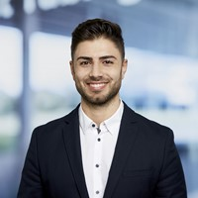




Speaker
Serkar Aydin
What to consider when setting up Business Process Automations
Serkar Aydin
serkar35857837
September 16th & 17th
^{Online Event}
Powered By
International Conference

